Slide 1
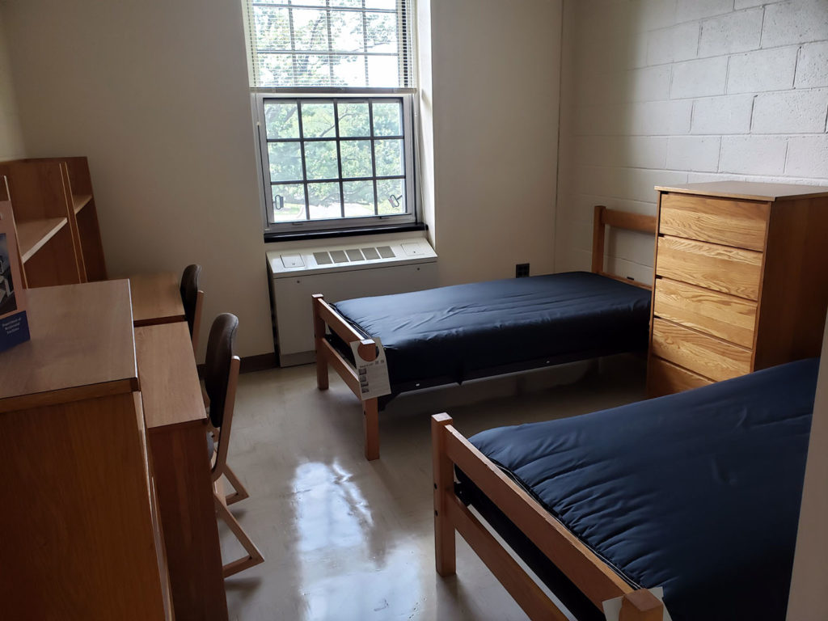

Project Bedroom

Slide 2
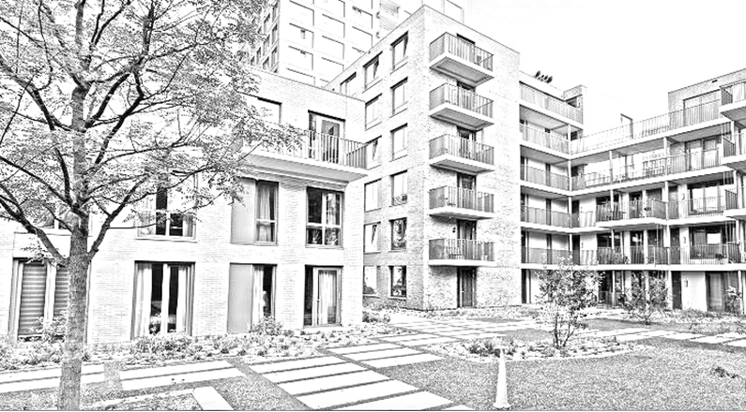
What Are We Doing?
Our task as a group was to create an app which will fix issues that students living in dorms have.

Slide 3

What Are Some Of the Problems Students May Have?
Appointed person not cleaning the shared facilities.
Students not paying for shared items.
Garbage disposal not being done on time.
Unannounced parties, gatherings, etc.

Slide 4


What Did We Use?
Windows Forms App (C#)
SQL Database
Encryption

Slide 5


App Functionalities (Student)
House Rules Tab
States the rules of the house that students must follow.
Tasks Tab
Adding tasks
Removing tasks
Reporting undone tasks
Shared Items Tab
Adding shared items to be paid by other fellow students.
Removing items.
Selecting students that have not paid yet.
Add Complaint Tab
Custom Complaints
Display/Statistics Tab
Seeing other students’ statistics
Complaints Tab
Seeing all the custom complaints students have anonymously made.

Slide 6
App Functionalities (Admin)
Students Control Tab
Adding students
Removing students
List of all students
Register Key Control Tab
Generating keys for registering.
Deleting a key
List of all generated keys
Rules Control Tab
Adding rules
Deleting rules
List of rules
Add Complaint Tab
Custom Complaints

Slide 7



THANK YOU!
Jose Navarrete Carbonell
Alexander Vartic
Menderes Sacli

